Slide 1

WIPRO NGA Program – Data Center Batch 9
Capstone Project Presentation –12th and 13th Aug
Project Title Here – Library Management System
Presented by – Triparna Sarkar
www.rpsconsulting.in

Slide 2
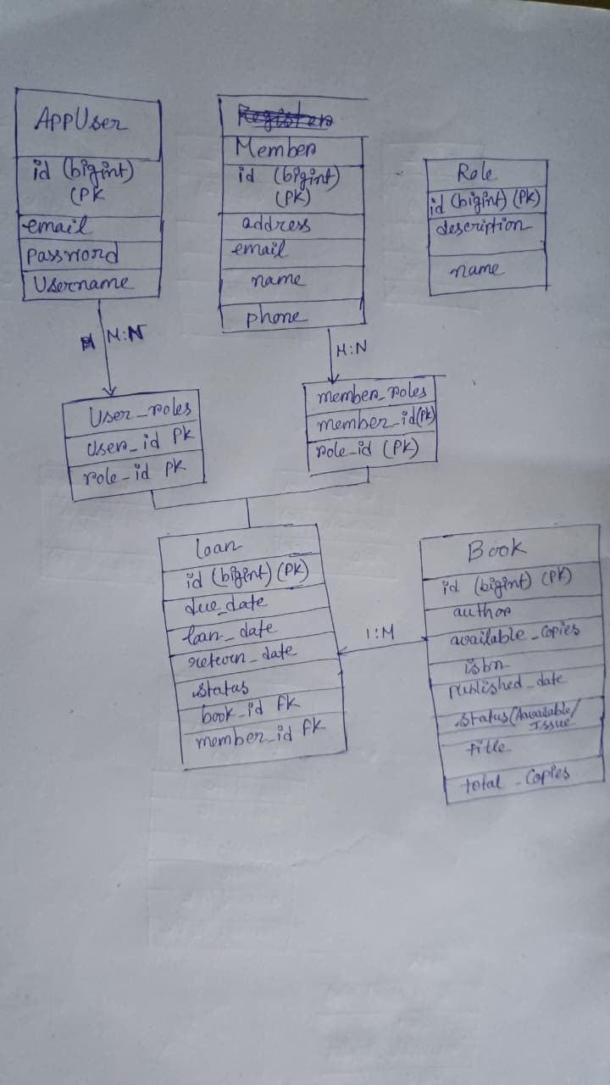

Class Er diagram
2025 - RPS Consulting all rights reserved

Slide 3
Testing Using Postman

Slide 4
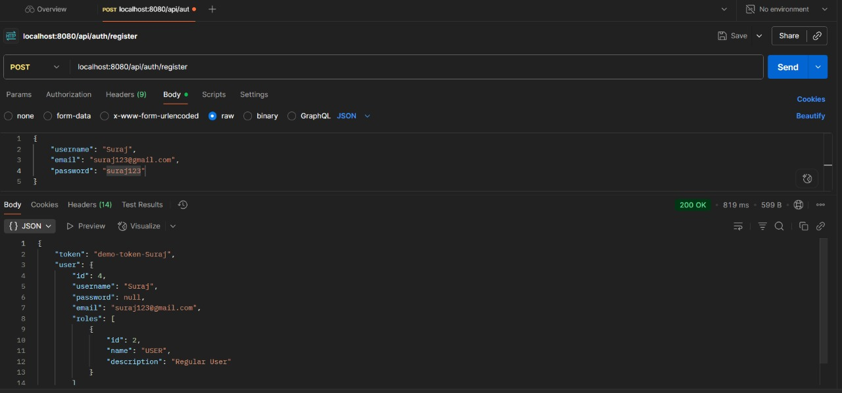
Registering user

Slide 5
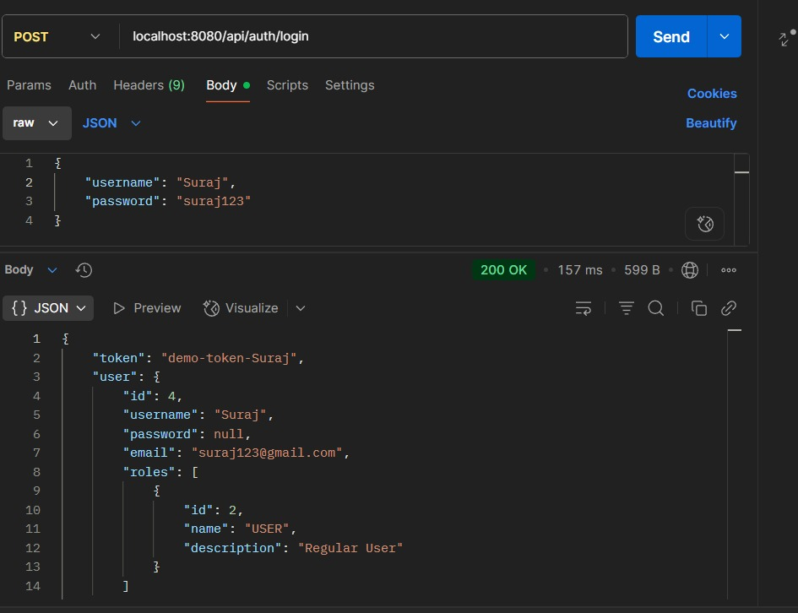
Login

Slide 6
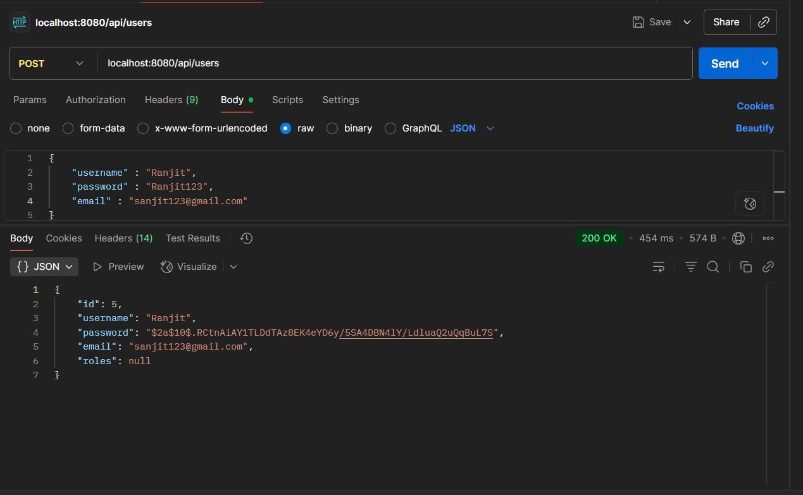
Add user

Slide 7
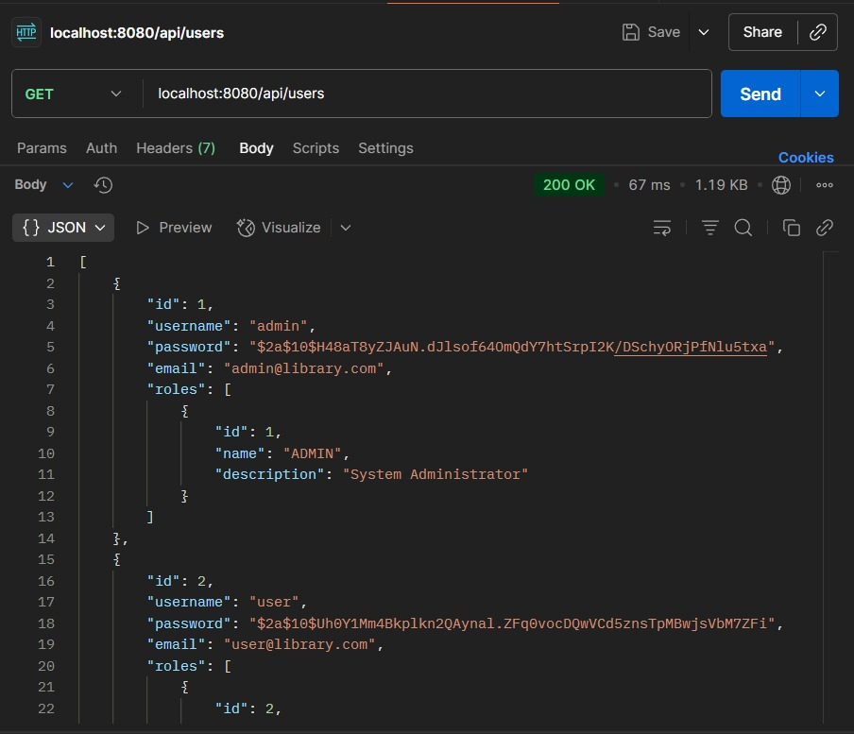
User List

Slide 8
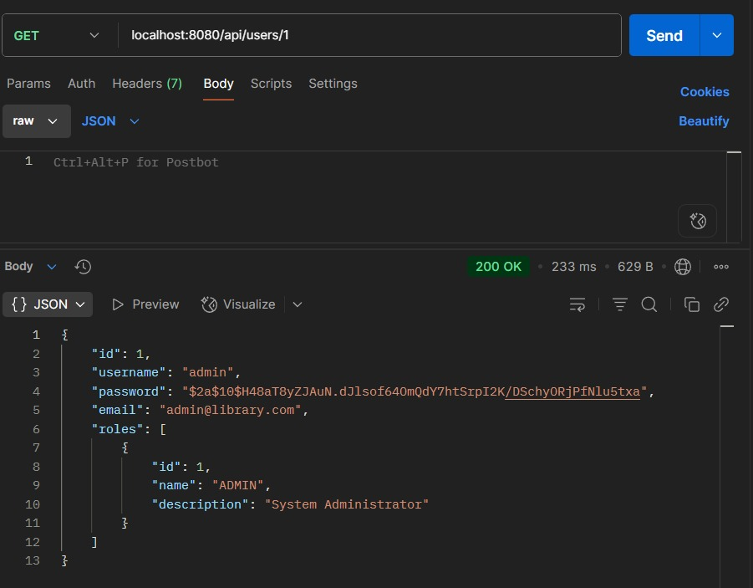
Get User By Id

Slide 9
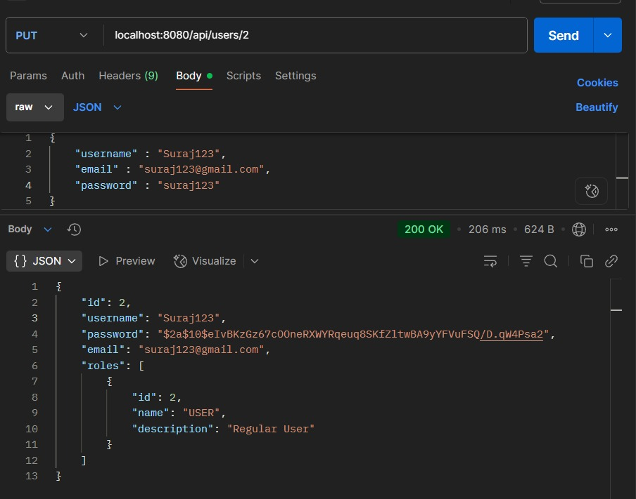
Update User By Id

Slide 10
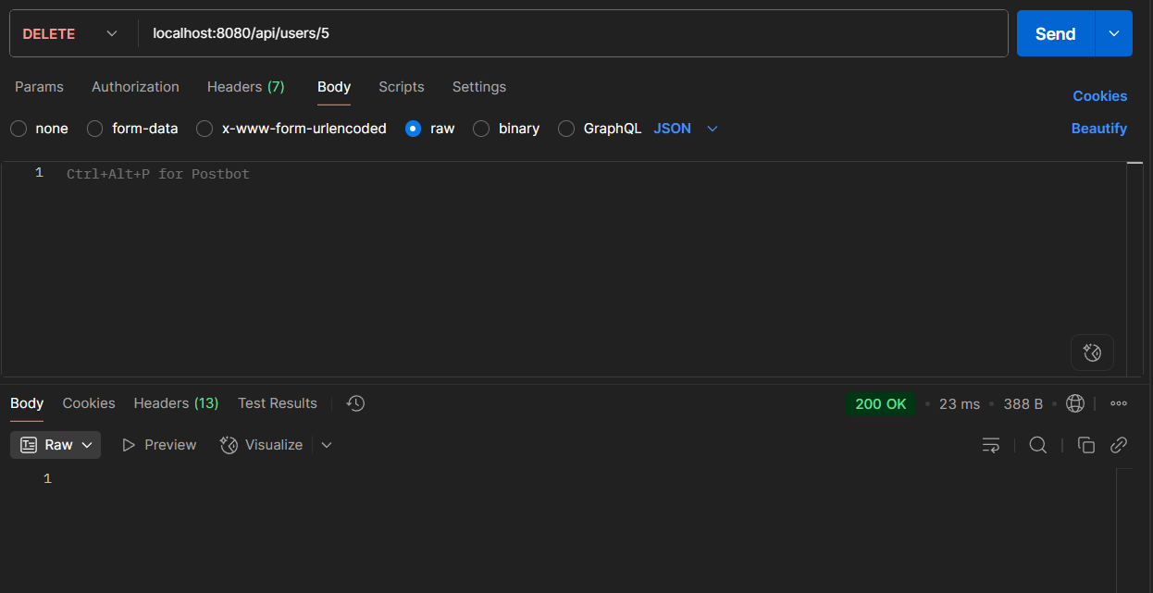
Delete User By Id

Slide 11
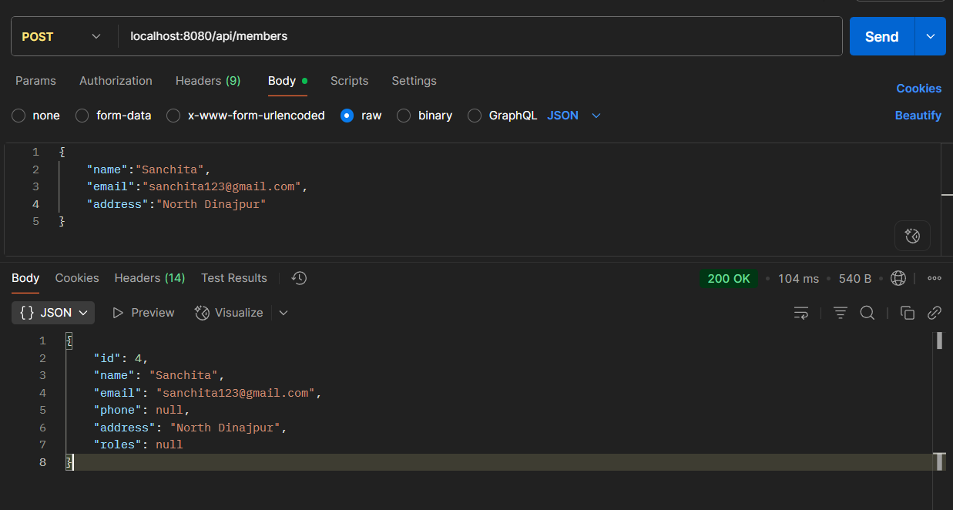
Adding Members

Slide 12
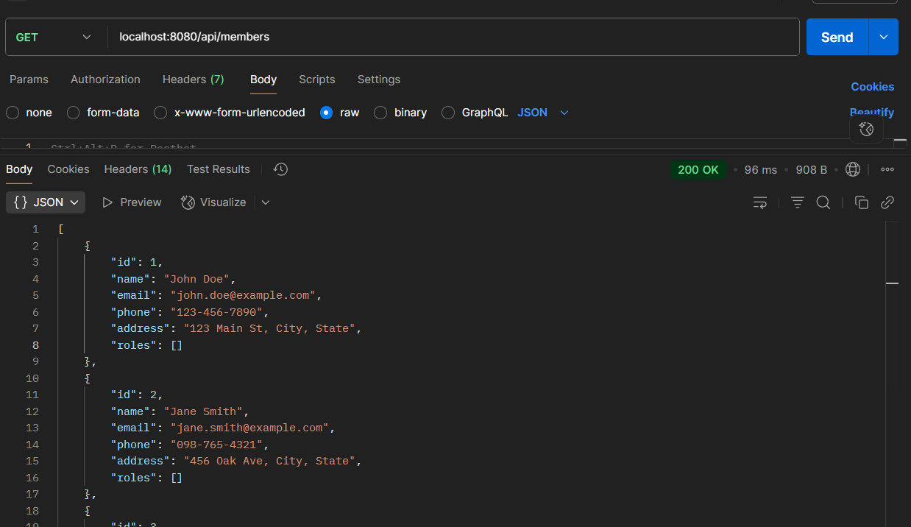
List of Members

Slide 13
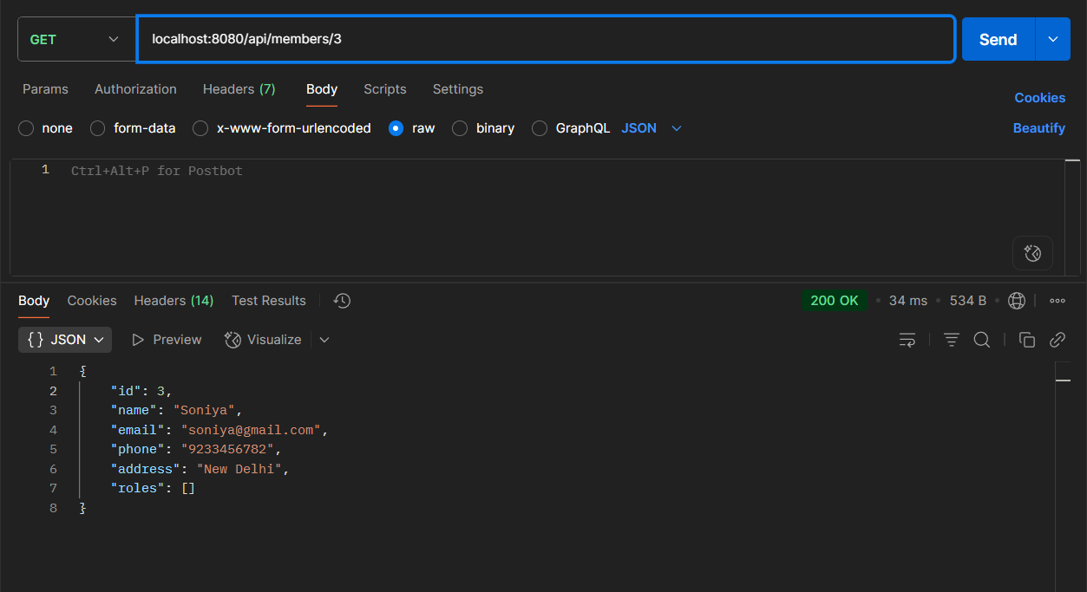
Get member by id

Slide 14
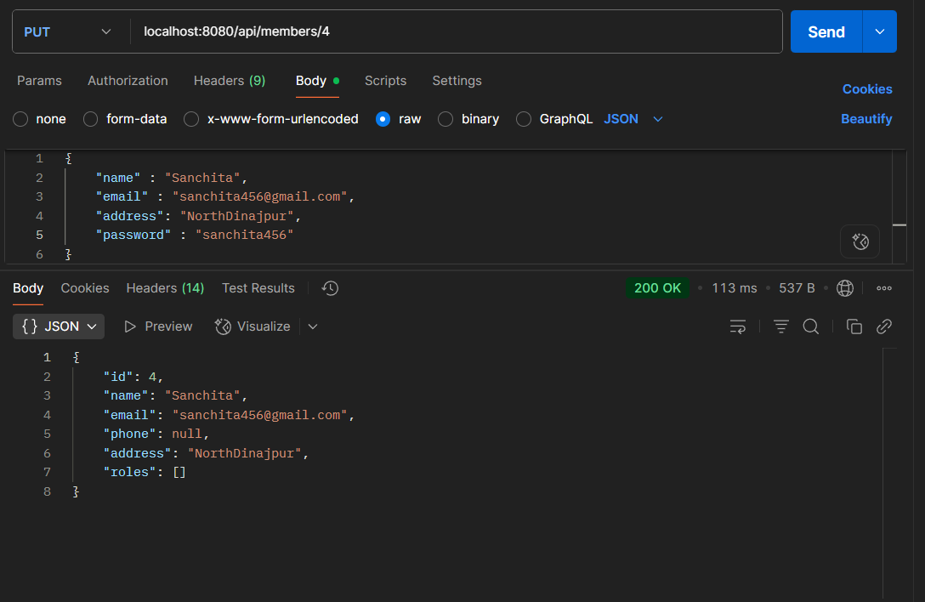
Update member by id

Slide 15
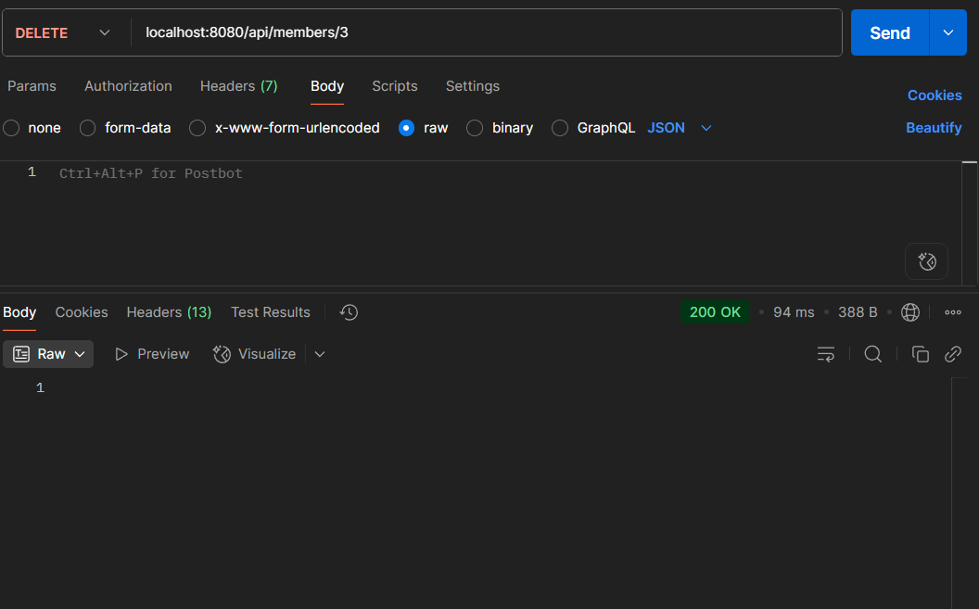
Delete member by id

Slide 16
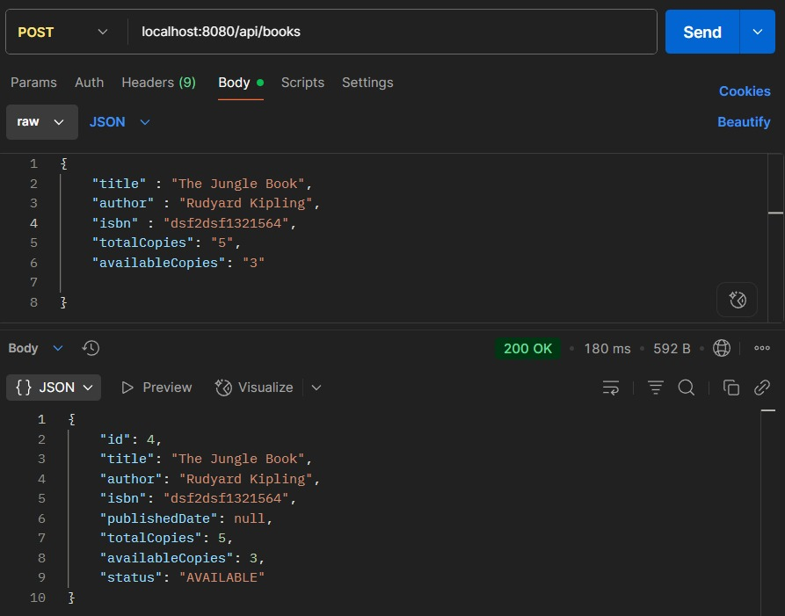
Adding Books

Slide 17
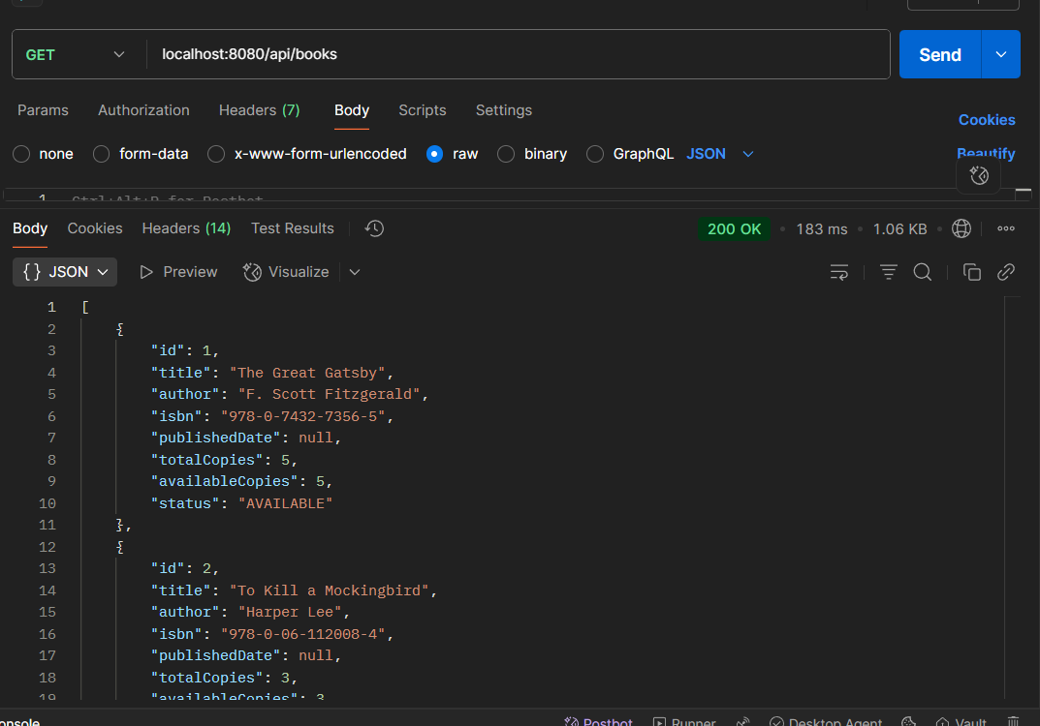
List of Books

Slide 18
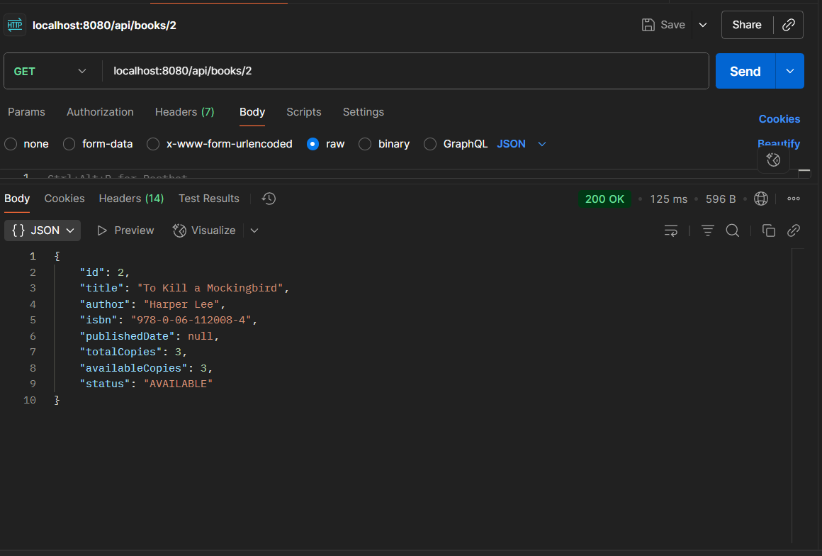
Get books by ID

Slide 19
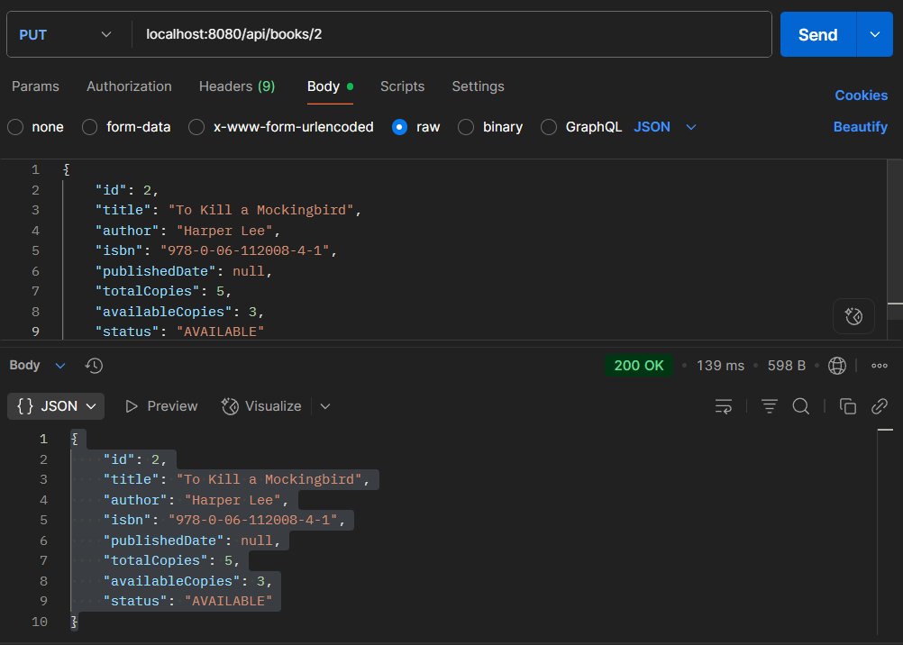
Update books by ID

Slide 20
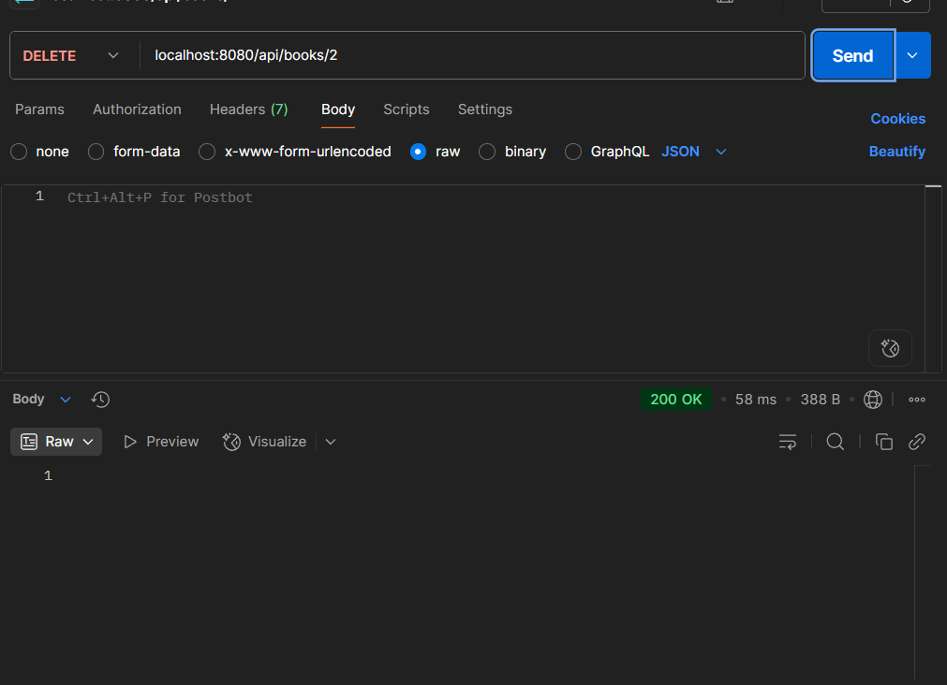
Delete books by ID

Slide 21
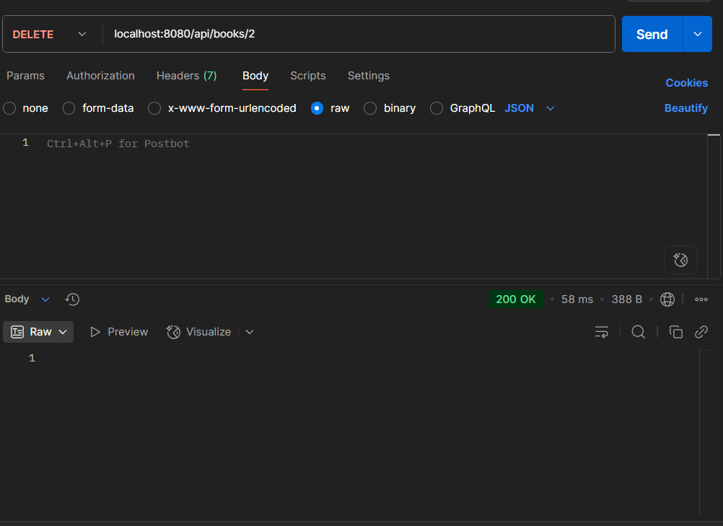
Delete books by ID

Slide 22
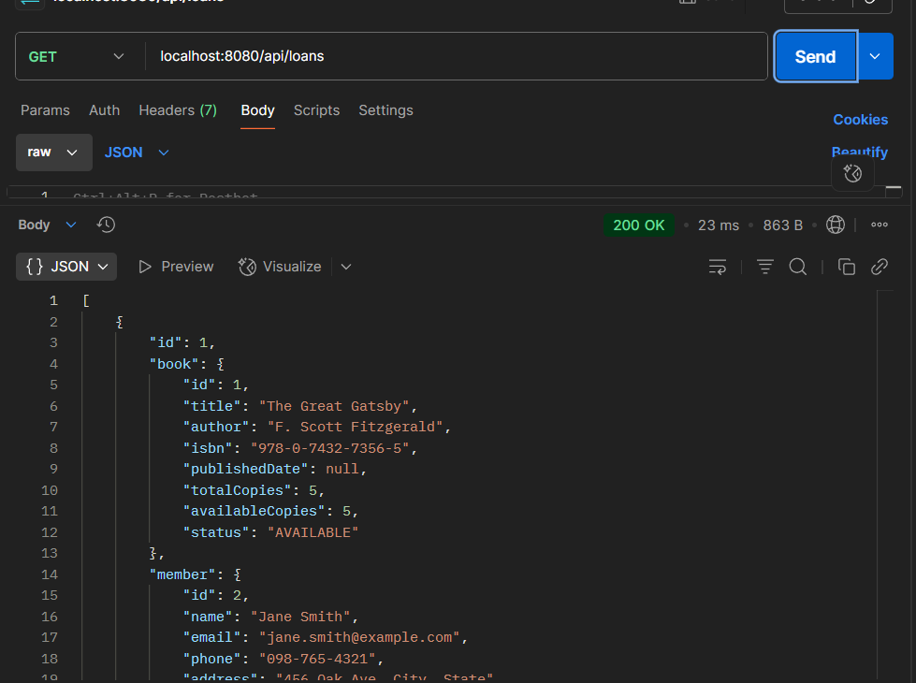
List of Loan

Slide 23
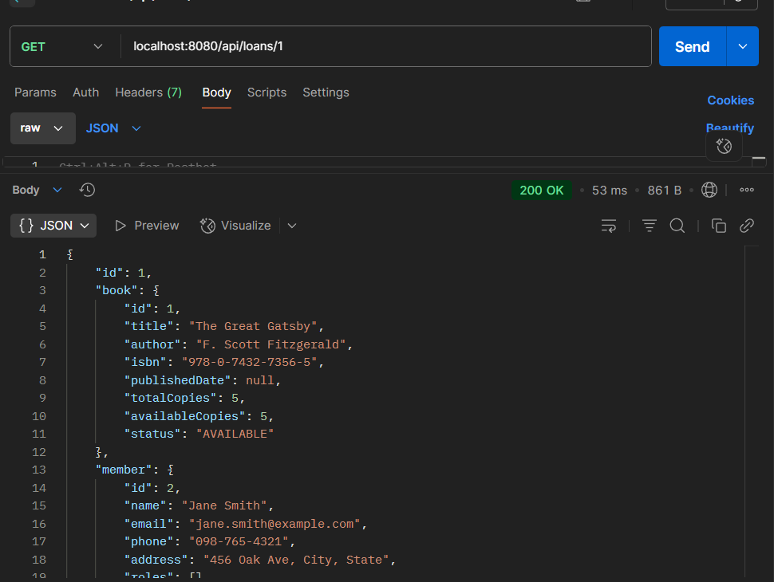
Get Loan By Id

Slide 24
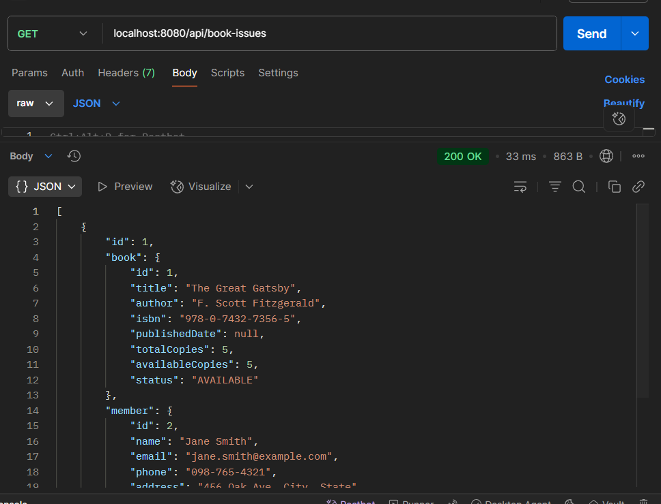
List of Issue book

Slide 25
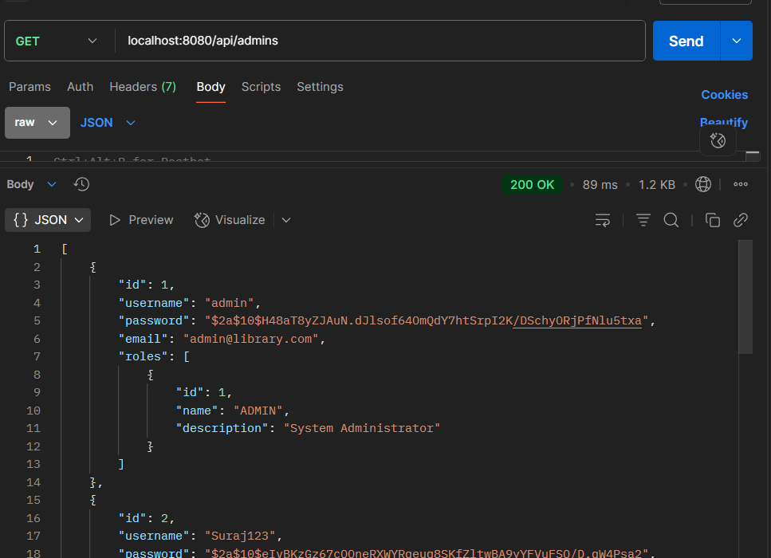
List of Admin

Slide 26
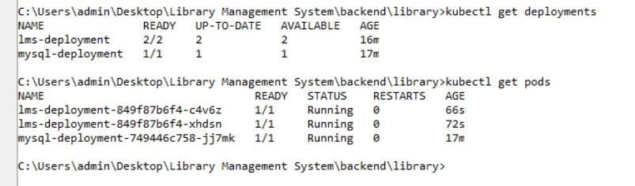
Kubernetes

Slide 27
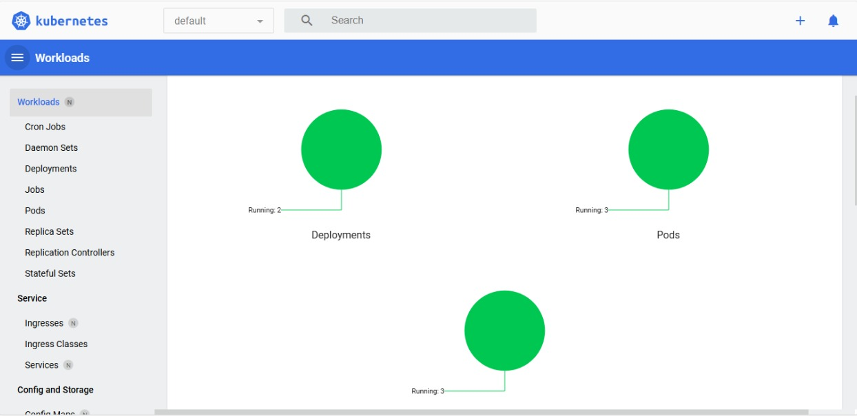

Slide 28
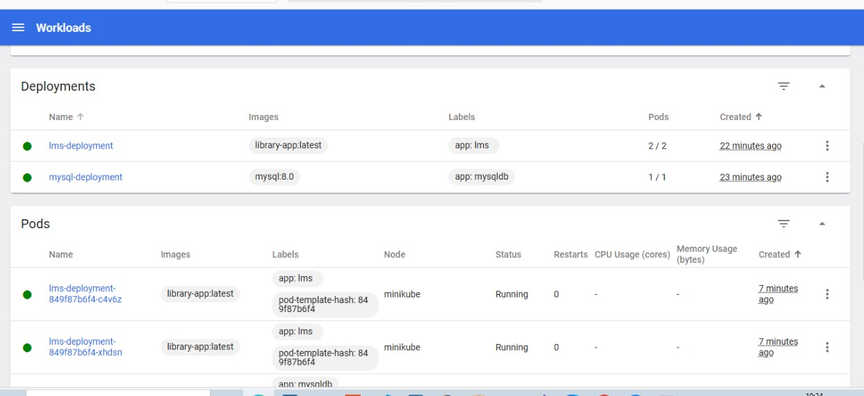

Slide 29
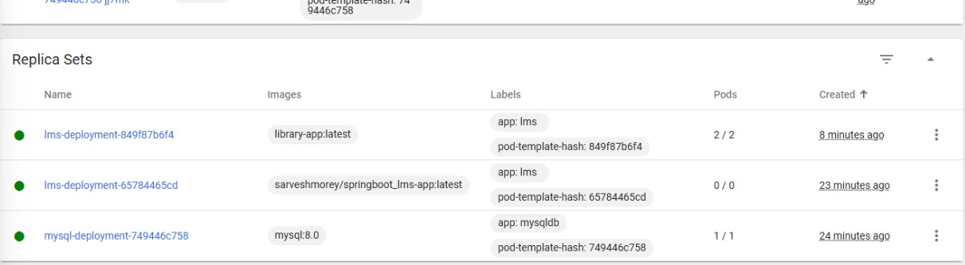

Slide 30
Library Management System

Slide 31
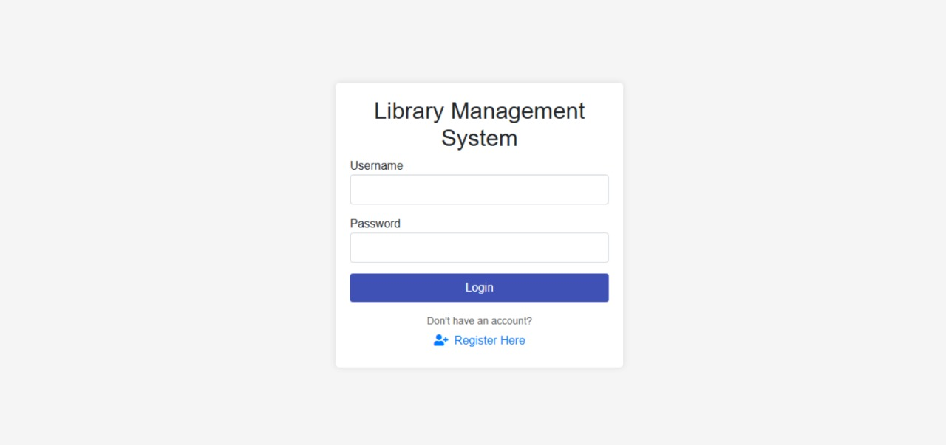
Login Page

Slide 32
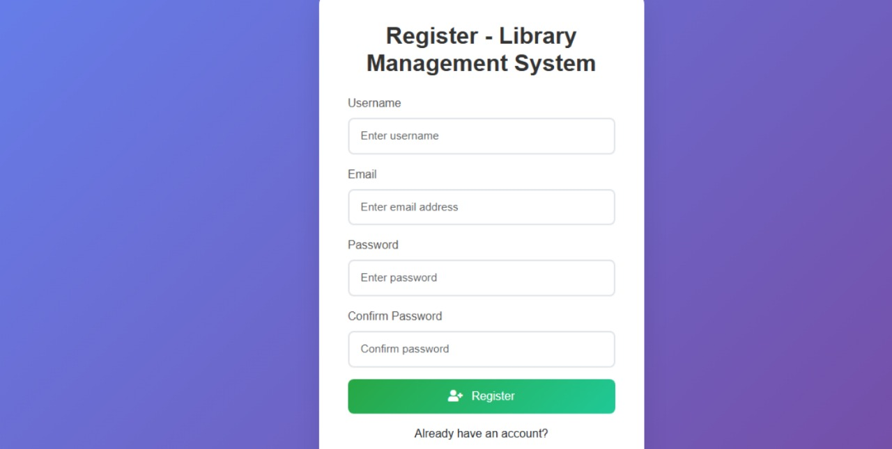
Registration Page

Slide 33
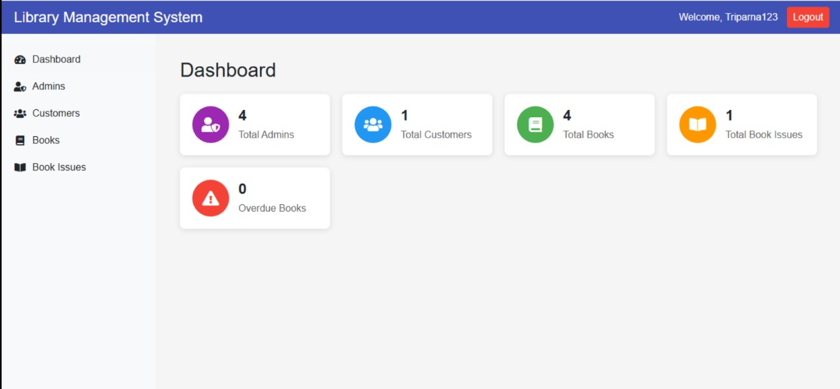
Dashboard Page

Slide 34
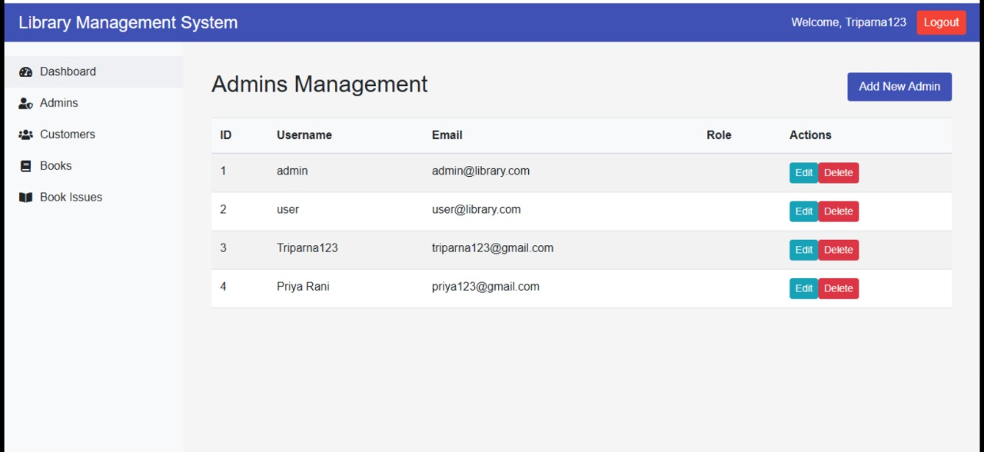
Admin Page

Slide 35
Admin Management page

Slide 36
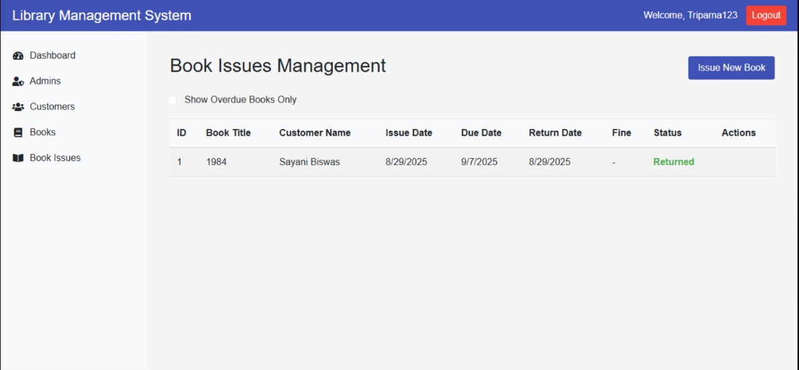
Book Isse Management Page

Slide 37
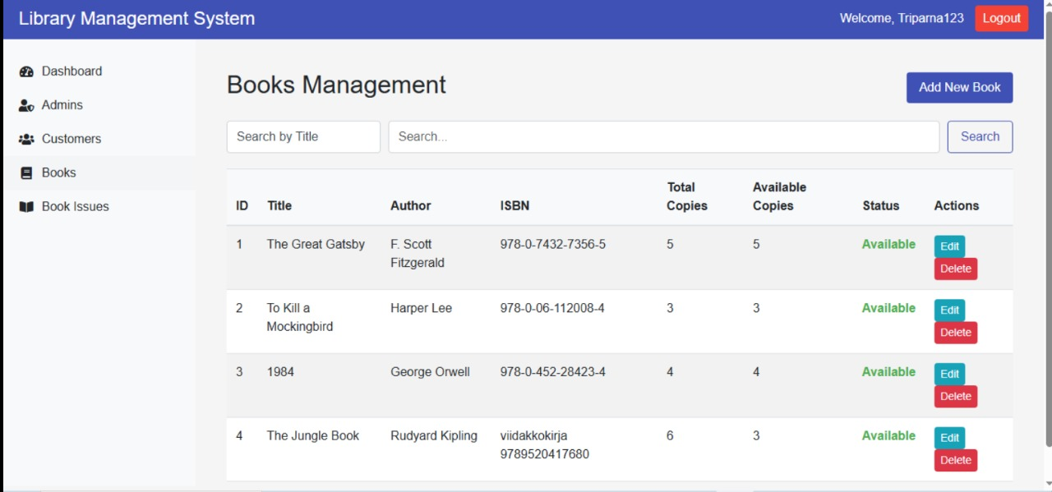
Book Management Page

